Slide 1
Week 9 AI: Case Studies, Challenges, Opportunities, Oh my!
Trenton Chramosta
Cybersecurity Engineer @NebMed
Adjunct Faculty @UNK

Slide 2
Case Studies

Slide 3
Case Study Example:
A car for a Dollar!?!?
This article show an example of “Prompt Engineering”
It’s a common issue in chat bot AI solutions to circumvent the intention of the implementors.
This showcases that someone still needs supervise chat bot outputs and guide to a more human response/reaction.

Slide 4
Research, and find
As part of the Reflection Paper go out and find a “case study”
E.g. an example of AI that has already been implemented or your own AI project.

Slide 5
Challenges

Slide 6
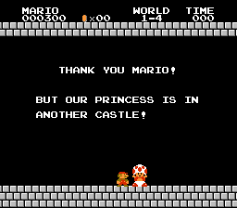
Refer back to Week 7
Slides are in
Presentation!

Slide 7
Opportunities

Slide 8
End User Education
There is a lot of hype surrounding AI
But rarely a decent understanding by the General Population

Slide 9
We are the SMEs
331.9M USA Population (US Census 2021)
2.19M are “IT/Cyber Systems” Professionals (DataUSA.io 2021)
2.19/331.9 = 0.6% of the population
As such, people will come to us on our takes when it comes to AI even if that isn’t your specialty.
This means we must be ready to meet our audiences where they are at and more often than not…
K.I.S.S.
Keep
IT
Simple
“Stupid”

Slide 10
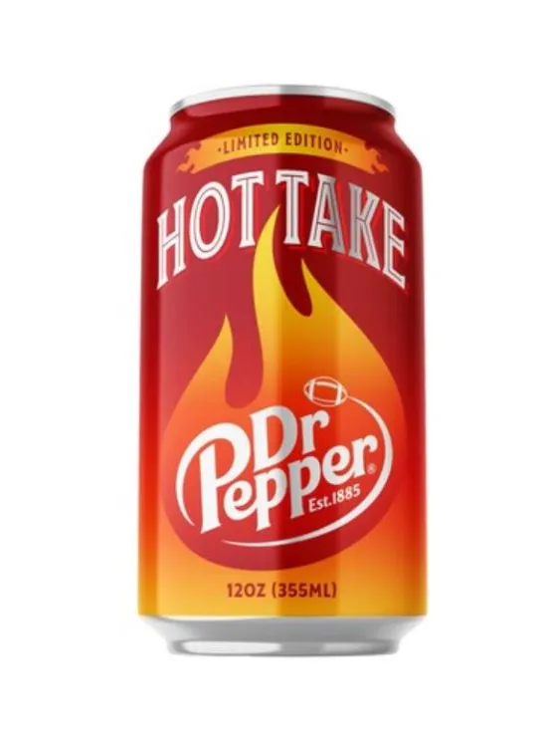
Dr. Pepper™ Break

Slide 11
Let’s move onto another presentation.
Go through SP19 Chapter 1
(If time) Go through SP19 Chapter 2
(If time) Go through SP19 Chapter 26

Slide 12
Section Transition

Slide 13
1 Text box
Hi Gang!

Slide 14
2 Text boxes
Hello
World

